Slide 1


Slide 2
“Strengthening the Social Service Workforce for Family-Based Care”

Slide 3

“Bringing lived experience to the social service workforce”
Voices of care experienced children, young adults and caregivers in Uganda

Slide 4

Approach

Slide 5
Desk Review and Inception Report: We assessed the existing progress and achievements in preparing and developing the workforce for family-based care through a desk review.
Participatory Assessment and Documentation: To capture the knowledge of lived experience of children, young people and family members, from their contact with the formal care system we organised focus group discussions.
Notes:
Desk Review and Inception Report: We assessed the existing progress and achievements in preparing and developing the workforce for family-based care across the three countries through a desk review.
Participatory Assessment and Documentation: We worked with national partners to capture the knowledge and lived experience of children, young people and family members, from their contact with the formal care system—including those with experience in residential care, foster care or formalized kinship care, and those that have left these forms of care to live independently or to be reintegrated back into families. After the learning is used determine the needs and gaps in workforce knowledge, attitudes and skills. Where appropriate, we will document the knowledge and experiences through videos, written testimonies and other creative media.
Development of Training Tools: We will use insights and creative media from the participatory assessments to develop engaging training tools that will transform the knowledge, attitudes and practices of social service workers so that they are motivated by, and skilled in, prioritizing family-based care over alternative care.
Development of Advocacy Tools: We will use insights and creative media from the participatory assessments to develop impactful advocacy tools that will raise awareness of the crucial role of social service workers in helping governments reform their care systems and of the need to increase long-term investment in this essential workforce.
Implementation of Training and Advocacy Tools: We will Implement training and advocacy tools in each country and make revisions based on learnings. Once finalized, we will disseminate tools at a global level for use in countries facing similar challenges.

Slide 6
Approach Continued…
Development of Training Tools: Insights and creative media from the participatory assessments were used to develop engaging training tools that are used transform the knowledge, attitudes and practices of social service workers so that they are motivated by, and skilled in, prioritizing family-based care over alternative care.
Development of Advocacy Tools: Responses from the participatory assessments and training tools informed the development of impactful advocacy asks that were used to create awareness of the crucial role of social service workers in helping governments reform their care systems and of the need to increase long-term investment in this essential workforce.
Implementation of Training and Advocacy Tools: Social service workforce will be trained using the developed tools . Once finalized, we will disseminate tools at a global level for use in countries facing similar challenges.
Notes:
Desk Review and Inception Report: We assessed the existing progress and achievements in preparing and developing the workforce for family-based care across the three countries through a desk review.
Participatory Assessment and Documentation: We worked with national partners to capture the knowledge and lived experience of children, young people and family members, from their contact with the formal care system—including those with experience in residential care, foster care or formalized kinship care, and those that have left these forms of care to live independently or to be reintegrated back into families. After the learning is used determine the needs and gaps in workforce knowledge, attitudes and skills. Where appropriate, we will document the knowledge and experiences through videos, written testimonies and other creative media.
Development of Training Tools: We will use insights and creative media from the participatory assessments to develop engaging training tools that will transform the knowledge, attitudes and practices of social service workers so that they are motivated by, and skilled in, prioritizing family-based care over alternative care.
Development of Advocacy Tools: We will use insights and creative media from the participatory assessments to develop impactful advocacy tools that will raise awareness of the crucial role of social service workers in helping governments reform their care systems and of the need to increase long-term investment in this essential workforce.
Implementation of Training and Advocacy Tools: We will Implement training and advocacy tools in each country and make revisions based on learnings. Once finalized, we will disseminate tools at a global level for use in countries facing similar challenges.

Slide 7
What we asked

Slide 8
Defining who is a social worker to various groups How is/ is social service support accessed?
What services are received from social workers and what support is missing. Are the unique needs of each family recognised?
What skills, attitudes and/ or knowledge do social service workers need to effectively support those with care experience?
Thinking about the skills, attitudes and/ or knowledge identified as important, what are the social service workers doing well and what are they failing to do/ not good at?
What are some of the strengths and gaps in the social service workforce system as a whole?
How do responses to these questions differ from the perspectives of children, care leavers, parents/ caregivers and social workers?

Slide 9
Who We Talked To

Slide 10
Care leavers - Male | 15
Care leavers - Female | 14
Fathers/ male caregivers | 22
Mothers/ female caregivers | 30
Boys - in families | 25
Girls - in families | 24
Total | 133

Slide 11
Part 1:Who supports a Family
Notes:
The aim is this part of the group discussion is to find out what role (if any) social workers play in supporting children and their families, particularly in relation to children’s care. The exercise also tries to find out what types of support children and their families want.

Slide 12
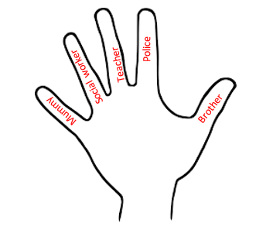
Helping hands
Notes:
The aim is this part of the group discussion is to find out what role (if any) social workers play in supporting children and their families, particularly in relation to children’s care. The exercise also tries to find out what types of support children and their families want.

Slide 13
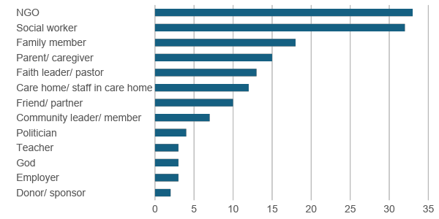
Who helps me and my family?

Slide 14
Who are social workers
GSSWA definition of a social worker
The social service workforce refers to a broad range of governmental and non-governmental, paid or unpaid, professionals and paraprofessionals who work with vulnerable children, youth, adults, older persons, persons with disabilities, families and communities to ensure healthy development and well-being. The social service workforce focuses on preventative, responsive and promotive services; they prevent and respond to violence, abuse, exploitation, neglect and family separation.
The social service workforce constitutes a broad array of practitioners, researchers, managers and educators, including – but not limited to: social workers, social educators, social pedagogues, child care workers, youth workers, child and youth care workers, community development workers/community liaison officers, community workers, welfare officers, social/cultural animators and case managers.

Slide 15
Female care leavers in Kampala discussion of what a social worker is:
“Someone working on behalf of an organization. The person who is in the field. Like a messenger for an organization. They go into the field and do research and take back information to the organisation, with the aim of helping.”
“A social worker is a mediator between the community and the organisation according to their required needs.”

Slide 16
Who supports a Family?
Notes:
What role should social workers play?
Case scenarios generated discussion and opportunities for participants to reflect on their own experiences.

Slide 17
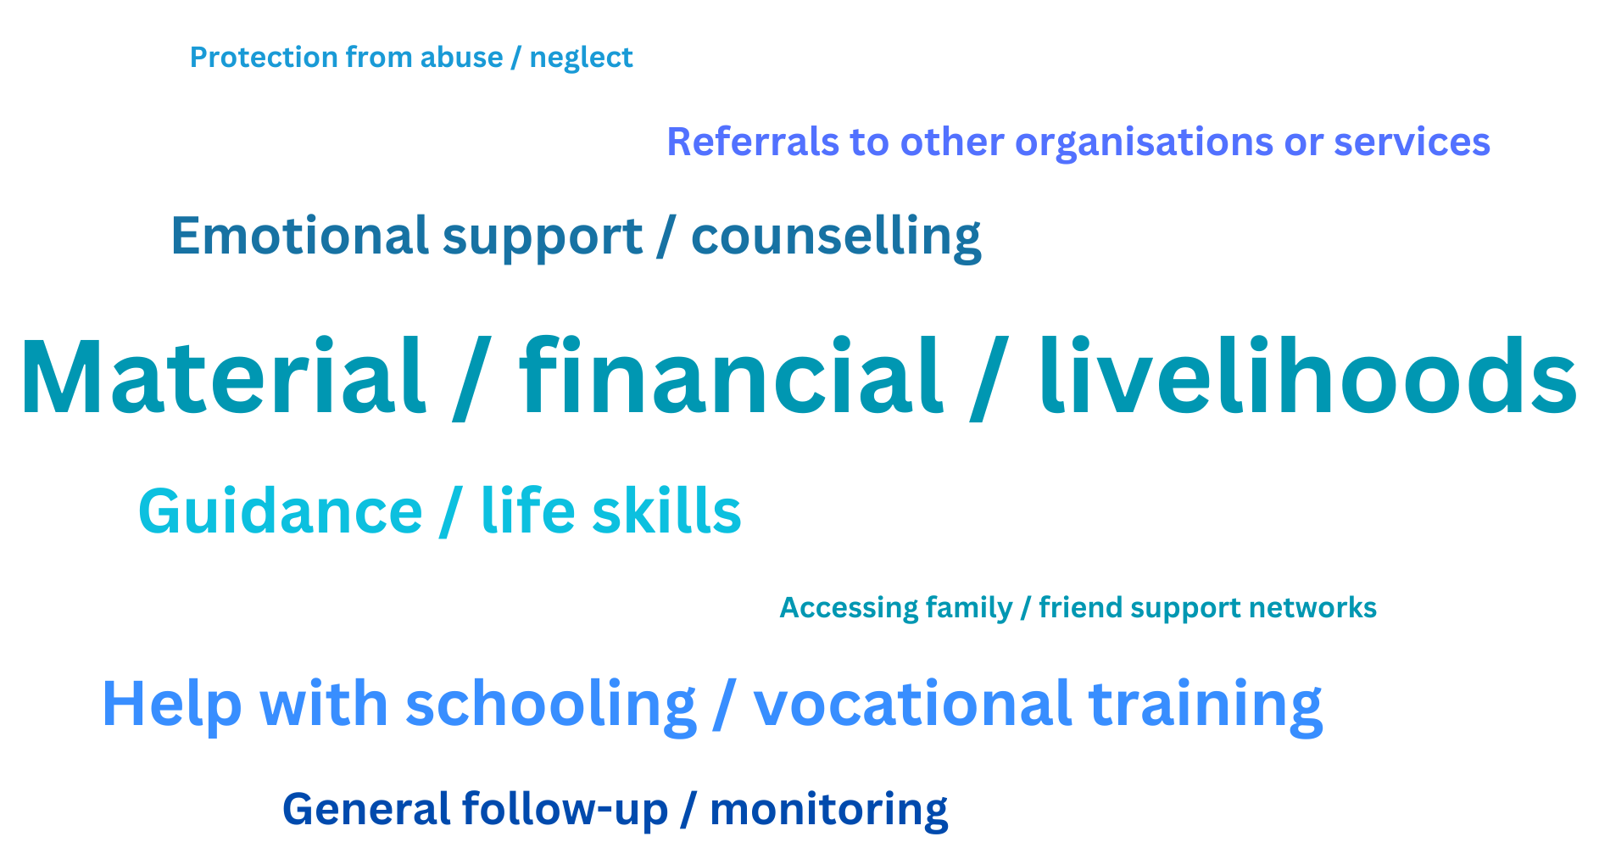
How can social workers help me and my family?

Slide 18
Key findings
Material Support
Overall, support for increasing household incomes was the form of support most mentioned during the group discussions.
“A social worker should start something for the family, initiating a program for the family that provides basic education on business, teaching them how to manage and sustain a family business effectively.” (Young woman care leaver, Kampala)
“For me at home our house had fallen down he brought materials and they built for us a house.” (Boy reintegrated from residential care, Mpigi)
Schooling and Vocational Training
The second most commonly mentioned form of support was help with schooling and vocational training, and this largely referred to help with school fees, books or uniforms (so another form of material support). Care leavers also highlighted the need for practical vocational training so that they could earn a living.
“They should pay for the school fees.” (Girl in a vulnerable family, Kampala)
“But a lot of times when we have failed to clear the school fees, I talk to Uncle X [a social worker] and he helps us.” (Girl in a vulnerable family, Mpigi)
Notes:
Note: Social Care Vs Social Protection
This suggests the need to examine the role of the social service workforce in social protection, in terms of the extent to which social service workers should be involved in social protection, and the skills they need to do this effectively.
Need to consider how the provision of material support may impact on the capacity of social workers to provide other forms of support. On the one hand, may mean having less time for their other roles, but as illustrated by this quote, may also enable relationships of trust to be built as a precursor for other forms of support.
Note: Social Care Vs Social Protection
This suggests the need to examine the role of the social service workforce in social protection, in terms of the extent to which social service workers should be involved in social protection, and the skills they need to do this effectively.
Need to consider how the provision of material support may impact on the capacity of social workers to provide other forms of support. On the one hand, may mean having less time for their other roles, but as illustrated by this quote, may also enable relationships of trust to be built as a precursor for other forms of support.

Slide 19
For children/ young adult care leavers:
Adjusting to life in the community for those leaving residential care (care homes were described as providing a structured existence where everything was provided, quite different from life in the community.
Care leavers needed help learning how to do simple household chores)
Relationships – with other family members, those in the community, friends, romantic relationships.
Discipline and moral guidance – the discipline required to get up and go to work or school, learning right from wrong, listening to elders, not mixing with ‘bad’ peers.
Finding work or choices in relation to their education
“While we are growing [in residential care], we have routine, we wake up, we shower , we play, we eat, we shower, we sleep, we do not learn anything. The life they give us is a rich life, a privileged life which is not forever. I think they should train us in real life experience. When you leave the orphanage, challenges there are many, they spoon feed us and when we leave we go back to zero.” (Young woman care leaver, Kampala)
“A good social worker should share with us knowledge that can help us to be better.” (Boy from a vulnerable family, Mpigi)
“Should be able to train and teach discipline not letting you only eat and sleep.” (Young woman care leaver, Kampala) ”
For parents/ caregivers:
Guidance on the importance of children remaining within families to prevent separation/ encourage reintegration.
Help dealing with challenging family dynamics
Our parents used to drink, spend money on unnecessary things and they had the mindset that investing in children was like a waste of money. so our parents would have been educated on many things like the value of educating a child and child growing up in a family.” (Young woman care leaver, Kampala)

Slide 20
Follow-up referred to social workers checking in with/ monitoring children, care leavers and families in relation to all aspects of their wellbeing, including how businesses were going, whether children were attending/ doing well in school, emotional wellbeing and relationships between family members. Seen as something that needs to be done regularly, and for care leaver and children reintegrated back into families, over a relatively long period of time (e.g., 2 years)
“We spend a lot of time in orphanages with social workers, and even though we return to our families, we’re often more accustomed to them than to our own family. It's important that they continue to provide counselling and support. Even if they can’t offer material assistance, ongoing counselling and follow-up are essential for helping us adjust and succeed.” (Young woman care leaver, Kampala)
Because she is young, she does not know the outside world, like about boys. People you see in the [care] home are your sister and brothers. You are used to being given everything so you don’t know anything about struggle. She needs counseling, briefing about the outside world, counseling on who she should mix with.” (Young woman care leaver, Kampala)
emotional support – participants spoke of social workers needing to listen to them, calm them down so that they could think rationally, reduce the stress and pressure they were under.
“I missed my family, siblings and parents. In a new place with new people you can't share some personal issues you would love to share, even the caretaker you fear to approach them to disclose the issues.”(Young woman care leaver, Kampala)”“No parent ever wants a child to be separated from their child, so the pain is too much. The pain even when you have eaten, you start asking yourself if my child is eaten, a lot but pain and causes depression.” (Mother of a child in residential care)

Slide 21
Continuum of care Vs role of a social worker
Preventing family separation
Material/ livelihoods support and help with school fees.
Educating/ counselling parents on the importance of children growing up in a family
Referrals to other organisations for services and support
Supporting children in residential care and their families
Helping children to adjust to their life in residential care, including support for making new friends so that they feel less lonely.
Providing emotional support to children who are missing their family and friends back at home, or who may be worrying about those that they have left behind. Children whose siblings are still living with parents may also feel discriminated against.
Providing emotional support to parents whose children are in residential care
Supporting Reintegration back to families
Life skills training and guidance on relationships to prepare children/ young people for living in the community (relationships include with family, friends and romantic relationships)
Persuading parents/ caregivers that children should return to their families, and assessing families to ensure they are safe and ready and able to care for children well.
Helping children to adjust to life in the community, including through on-going guidance on life skills and relationships once in the community

Slide 22
Part 2: The skills, knowledge, attitude and behavior of ‘good’ and ‘bad’ social worker
Notes:
The aim of this part of the group discussion is to explore the participants perspectives on what makes a good and bad social worker, thinking about social workers knowledge, skills, attitudes and behaviour.

Slide 23
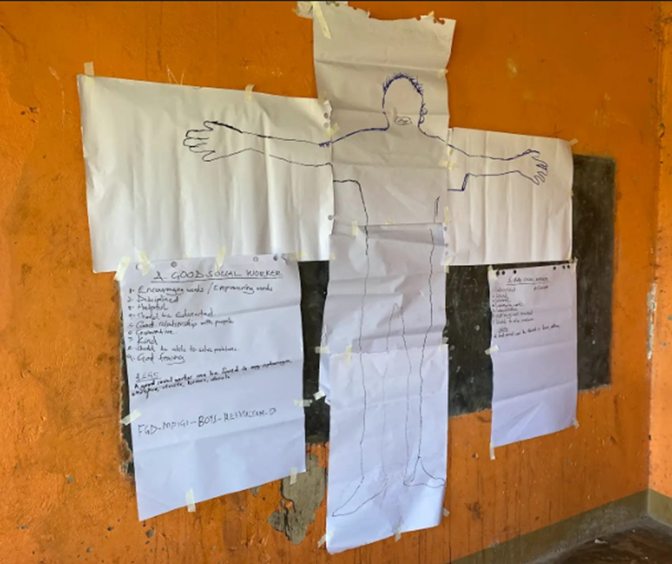
Body map

Slide 24
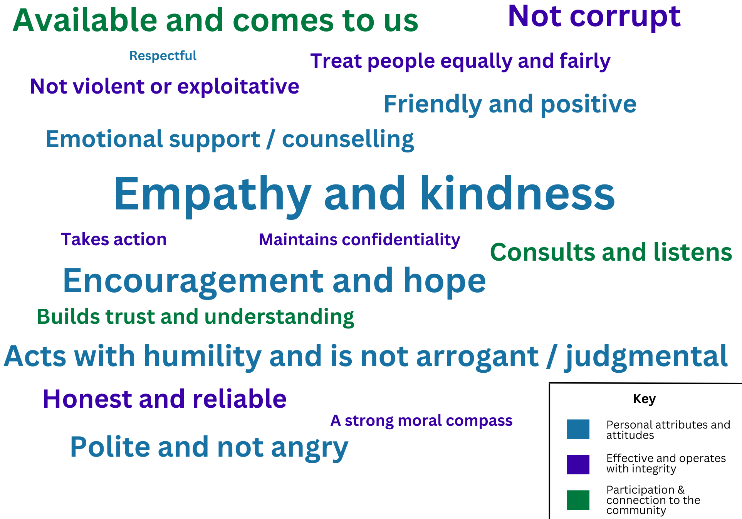
What makes a good social worker?

Slide 25
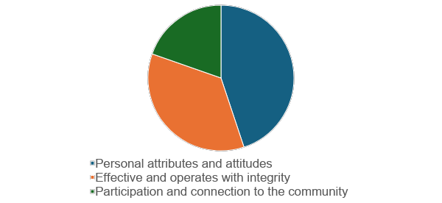
What makes a good social worker? - by category

Slide 26
Personal attributes and attitudes
  Empathy and kindness- seeks to understand problems &wanting the best for others
  “A bad social worker talks to you with no empathy at all, they make you feel like this is all your fault , like it's your doing and you deserve it.” (Female care leaver, Kampala)
  Offering encouragement and hope
  “This social worker should understand my pain and the difficulties I might be facing.” (Female caregiver from a vulnerable family, Kampala)
  Being polite and not getting angry-Being calm, not getting annoyed, not losing their temper, and shouting at you
“This social worker may find a person who is rude or cruel and instead of talking to that person kindly or humbly, then they would just respond or shout in a bad way. Because when you find someone cruel, you also want to be cruel. So you end up fighting or quarrelling.” (Girl from a vulnerable family, Mpigi)
  Friendly and positive
  “A good social worker should make you her friend and bring you close and shows you love so that you can be able to open up.” (Female caregiver from a vulnerable family, Kampala)
  Acts with humility – is not superior, arrogant or judgemental
"A bad social worker] makes you feel like they are doing you a favor, a very big one, they keep reminding you of your background.” (Female care leaver, Kampala)

Slide 27
Being effective and operating with integrity
  Not being corrupt- different forms including keeping goods or a proportion of goods meant from clients, asking for payment for services which were supposed to be free.
  “Like he takes what he is supposed to give you and gives it to someone else, or even for himself.” (Female care leaver, Kampala)
  Maintaining confidentially- not sharing information with other people, not gossiping about them
  Being honest and reliable- does what they say they are going to do
  Social workers have this habit of treating us differently when there are visitors. When visitors come, they pretend to be nice to you yet they are not.” (girl, Mpigi)
  Treating people equally and fairly-Consistently behaves well – not just for show
  “They have favoritism, even when we were In the Home there are those children that are treated nicely and those ones that are not.” (Female care leaver, Kampala)
  Not being violent or exploitative- children and care leavers who had been in residential care spoke of social workers beating them, or making them carry out chores involving heavy lifting
  Having a strong (religious based) moral compass - value of social workers being religious or God fearing so that their positive behaviours was embedded in deeper beliefs
  Easy to identify as a social worker -A good social worker should have an identification because some people may come to the community when they are not social workers.” (Male caregivers from a vulnerable family, Kampala)

Slide 28
Participation and connection to the community
  Available, easy to contact, comes to the community
  “A good social worker should visit the family and gets to know the problems you’re facing and goes back and gets support and gives it to you.” (Woman from a vulnerable family, Kampala)
  Consults and listens carefully
“Be good listeners – giving advice and not making decisions for us. They may need to make decisions for kids, but not for someone who is over 18. They just need to guide them, not make their decisions.” (Female care leaver, Kampala) ”
“Well you will be talking to them and they say, ‘it's not that bad, it could have been worse,’ showing no interest at all in whatever you’re telling them, they behave like wherever you’re telling them they have heard it before so it's not new and you should not make it a big deal.” (Female care leaver, Kampala
  Takes time to build trust and understand the community
“Sometimes the social workers are talking to you while they are in rush, not giving you time to tell them anything.” (Female care leaver, Kampala)
Taking action
Instead of being in office with the heads of the orphanage they should give us time one or one with the social worker in privacy” (Female care leaver, Kampala)
Recognize that need to build up relationships of trust before people will share the true situation

Slide 29
Conclusion and policy implications
After capacity gap analysis, would aim to make recommendations/ highlight policy implications in relation to:
The role and functions of social workers (as expressed in policies, job descriptions, actual roles they play)
Care reform processes – and how social workers should be able to contribute to this for success
Recruitment of social workers – kind of attributes and motivations should consider
Training, supervision and other capacity building for social workers
Regulation and monitoring of social workers
Resource allocation for social work and the support that social workers need to fulfil these functions
Linkages to other sectors -especially education and social protection

Slide 30
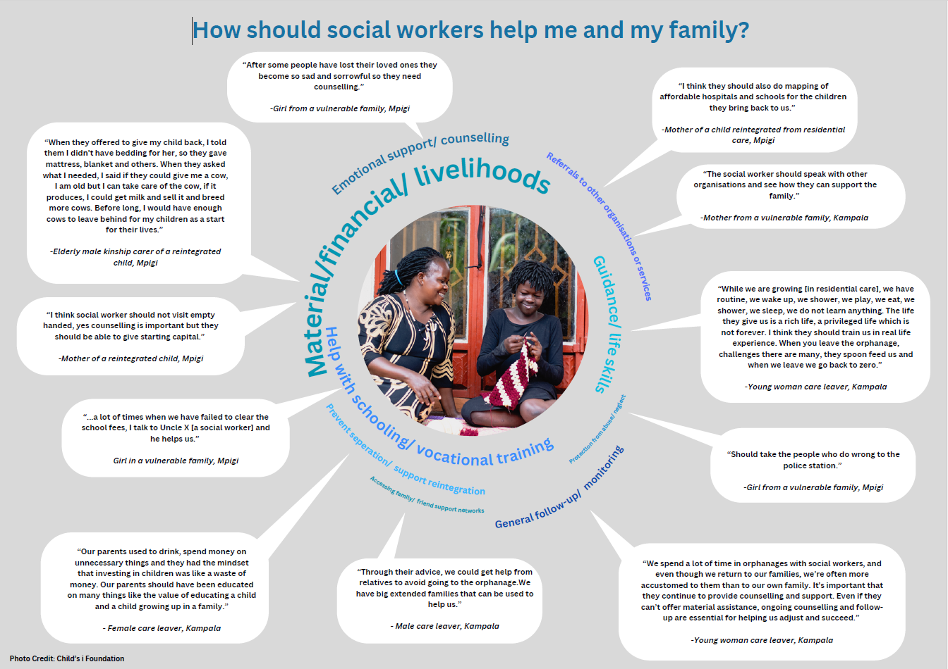
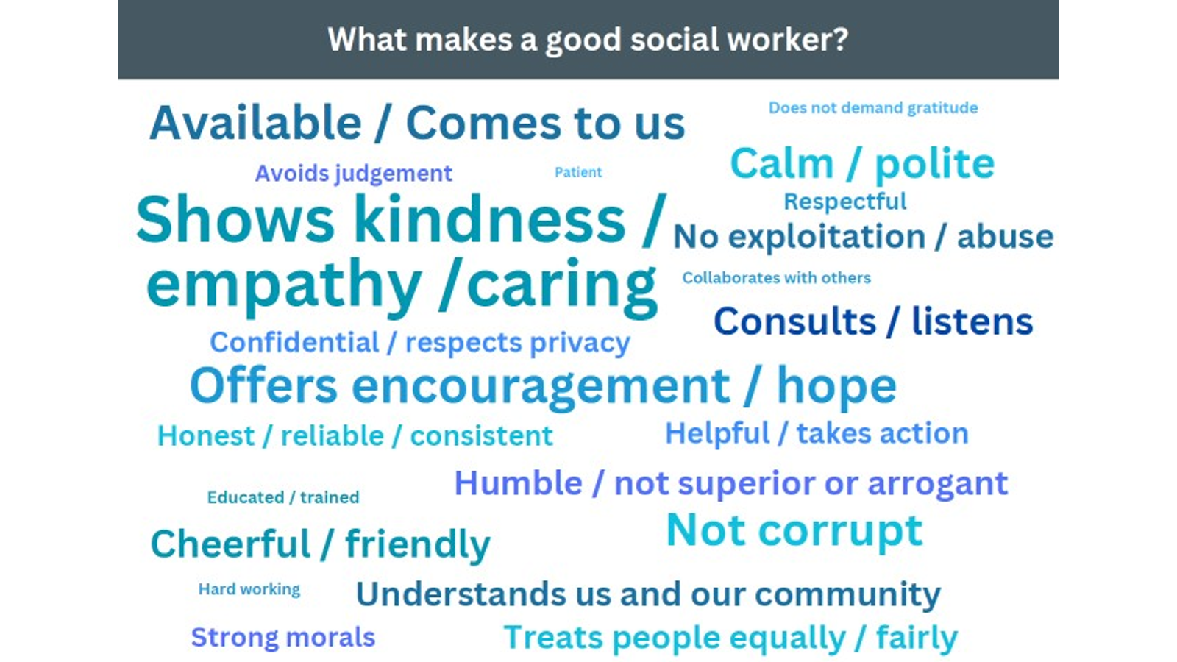
Tools developed
Development of Training Tools: We used insights and creative media from the participatory assessments (consultations) to develop a Facilitator manual to guide training of social workers and community volunteers, Tool 1-Poster –How should social workers help me and my family? ,tool 2 A handout –What makes a good social worker with a video and tool 3 case studies of Edith and Eric

Slide 31
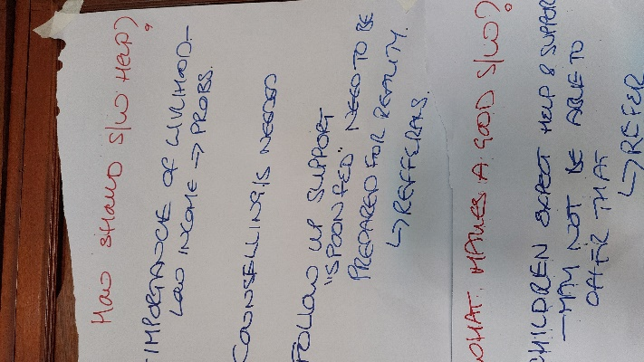
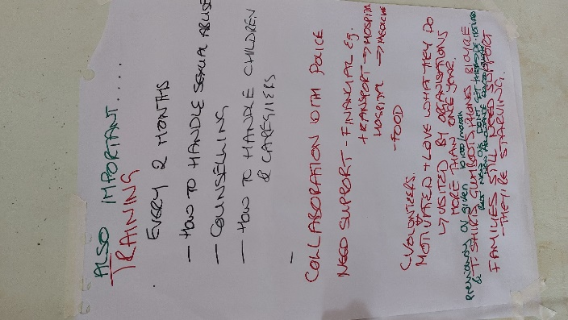
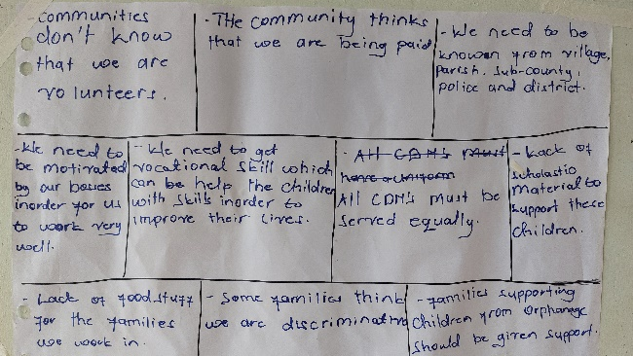
Tool testing with social workers and community volunteers
Social workers-NGOs,Govt,Community volunteer & Children Home manager-Reflecting on the roles highlighted from consultations.
Building capacity of social workers to handle to handle sexual violence, counselling and how to handle children, young people and care givers with lived experience
Refresher trainings for social workers
Collaboration with police to support incases of violence
Importance of livelihood to families & care givers and young people
Renumeration and motivation for social workers and community volunteers
Follow ups for CEPs after living care
Need for children homes to instill life skills for young people preparing them for life after care
Training for community volunteers on how to support reintegrated families and community participation
Collaboration with other key stakeholders through referrals

Slide 32
THANK YOU!

